Slide 1
Superstore Sales Data

Slide 2
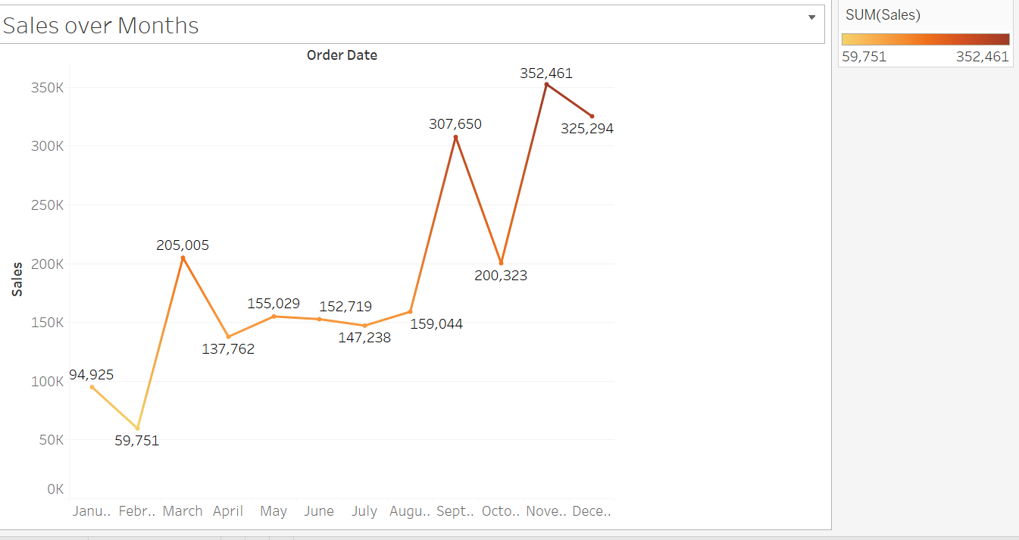
Sales over Months

Slide 3
Peak Sales: October records the highest sales at 352,461, followed by November at 325,294.
Lowest Sales: February has the lowest sales at 59,751, indicating a significant dip.
Seasonal Trends: Sales show a general upward trend from February to October, with a peak in October, followed by a slight decline in December (200,323). There’s a noticeable dip in May (137,762) and August (147,238).
Volatility: Sales fluctuate significantly month-to-month, with a sharp drop from April (200,005) to May and a steep rise from September (159,044) to October.
Actionable Insight: The strong performance in Q4 (October and November) suggests a seasonal peak, possibly due to holiday sales. Strategies to stabilize sales in low-performing months like February and May could help maintain consistency.

Slide 4
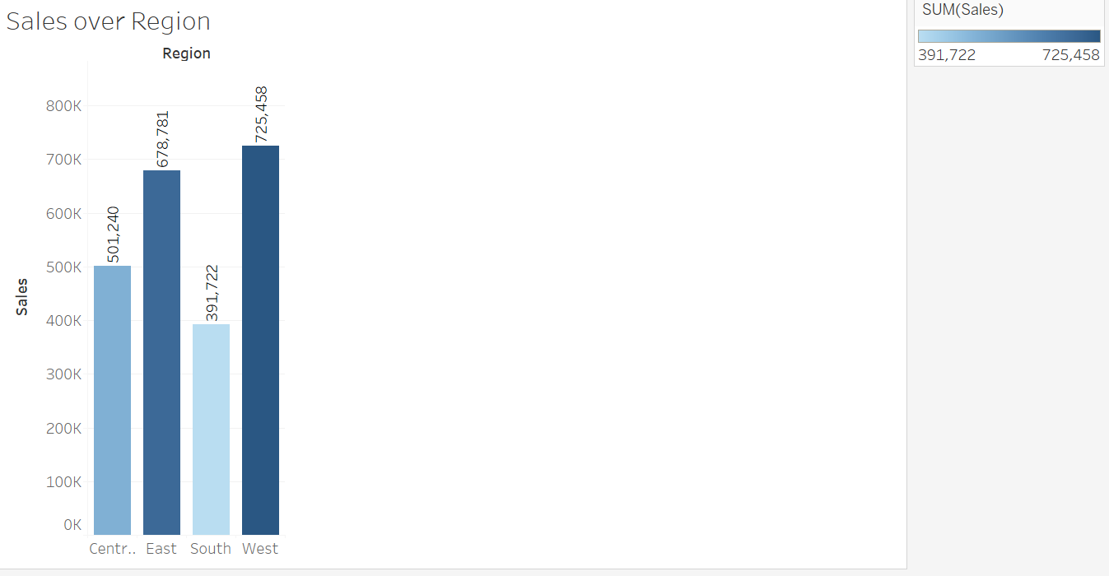
Sales Over Region

Slide 5
Highest Sales: The West region leads with the highest sales at 725,458, significantly ahead of other regions.
Lowest Sales: The South region has the lowest sales at 391,722.
Regional Disparity: There’s a notable disparity in sales performance, with the West outperforming the South by nearly 85%. The East and Central regions fall in the middle with 681,878 and 501,240, respectively.
Opportunity for Growth: The South and Central regions may present opportunities for targeted strategies to boost sales, as they lag behind the West and East.

Slide 6
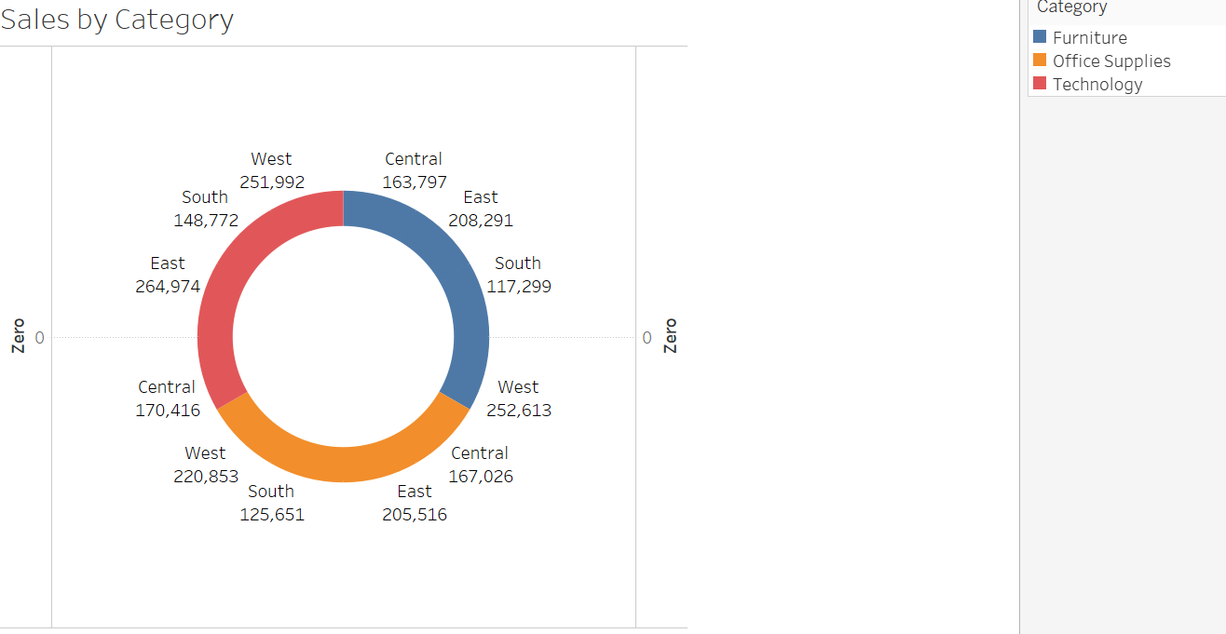
Sales by Category

Slide 7
Category Breakdown:
Technology: Leads across all regions, with the East at 264,974 and West at 251,992.
Furniture: Second-highest category, with the East at 208,291 and Central at 163,797.
Office Supplies: Lowest overall, with the South at 117,299 and Central at 167,026.

Slide 8
Regional Preferences: The East excels in Technology (264,974) and Furniture (208,291), contributing to its high sales in the first chart.
The West also shows strength in Technology (251,992), aligning with its top regional sales.
The South underperforms across all categories, especially in Office Supplies (117,299).
Category Performance: Technology is the strongest category across all regions, indicating a high demand for tech products. Office Supplies consistently underperform, suggesting lower demand or market saturation.

Slide 9
Summary
Regional Strategy: The West and East are strong performers, driven by Technology sales. The South and Central regions need targeted interventions to improve sales, possibly through promotions or expanding product offerings.
Seasonal Planning: Leverage the Q4 peak (October-November) for major campaigns, while addressing the February and May slumps with promotions or inventory adjustments.
Category Focus: Prioritize Technology products, as they drive sales across all regions. Investigate underperformance in Office Supplies to either improve or reallocate resources to stronger categories like Technology and Furniture.

